Slide 1
BCRS Recruitment Company “Leave finding your dream job to us”

Slide 2
The Brisbane Broncos are looking for a Merchandise Manager THAT POSSESS…
Strong work ethics
Strong leadership skills
A team player
Excellent interpersonal communication skills
WE BELIEVE THE ABOVE QUALATIES YOU HAVE AND WE WOULD BE DELIGHTED FOR YOU TO

Slide 3
THE BRISBANE BRONCOS ARE LOOKING FOR…

Slide 4
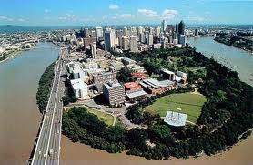
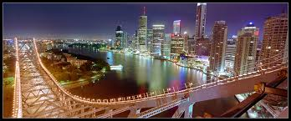
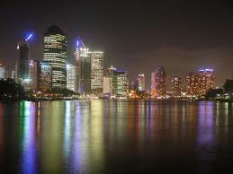
Brisbane, Australia

Slide 5
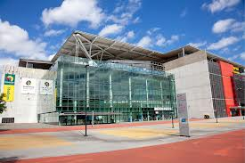
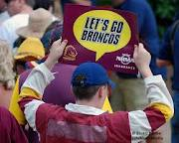
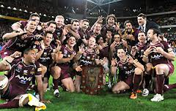
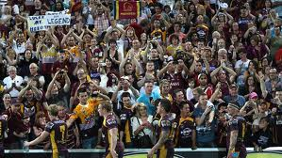
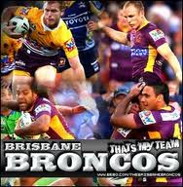
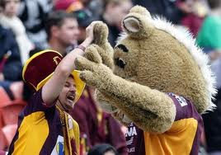
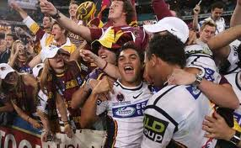
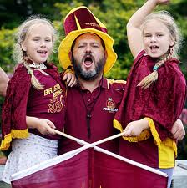
BRISBANE BRONCOS NATIONAL RUGBY LEAGUE FOOTBALL CLUB

Slide 6
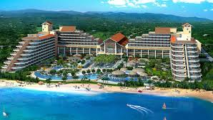
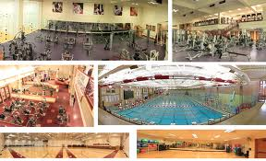
COMPENSATION PACKAGE
Competitive salary
Life insurance
401k program
Paid vacations and holidays
Universal health care

Slide 7
THANKS FOR YOUR TIME AND WE HOPE YOU DECIDE TO EMBARK UPON THIS JOURNEY WITH THE BRONCOS!!
BCRS Recruitment Company:
Natasha Brackett
Malcolm Robinson
Natalie Caldwell
Carl Samuels

